Slide 1
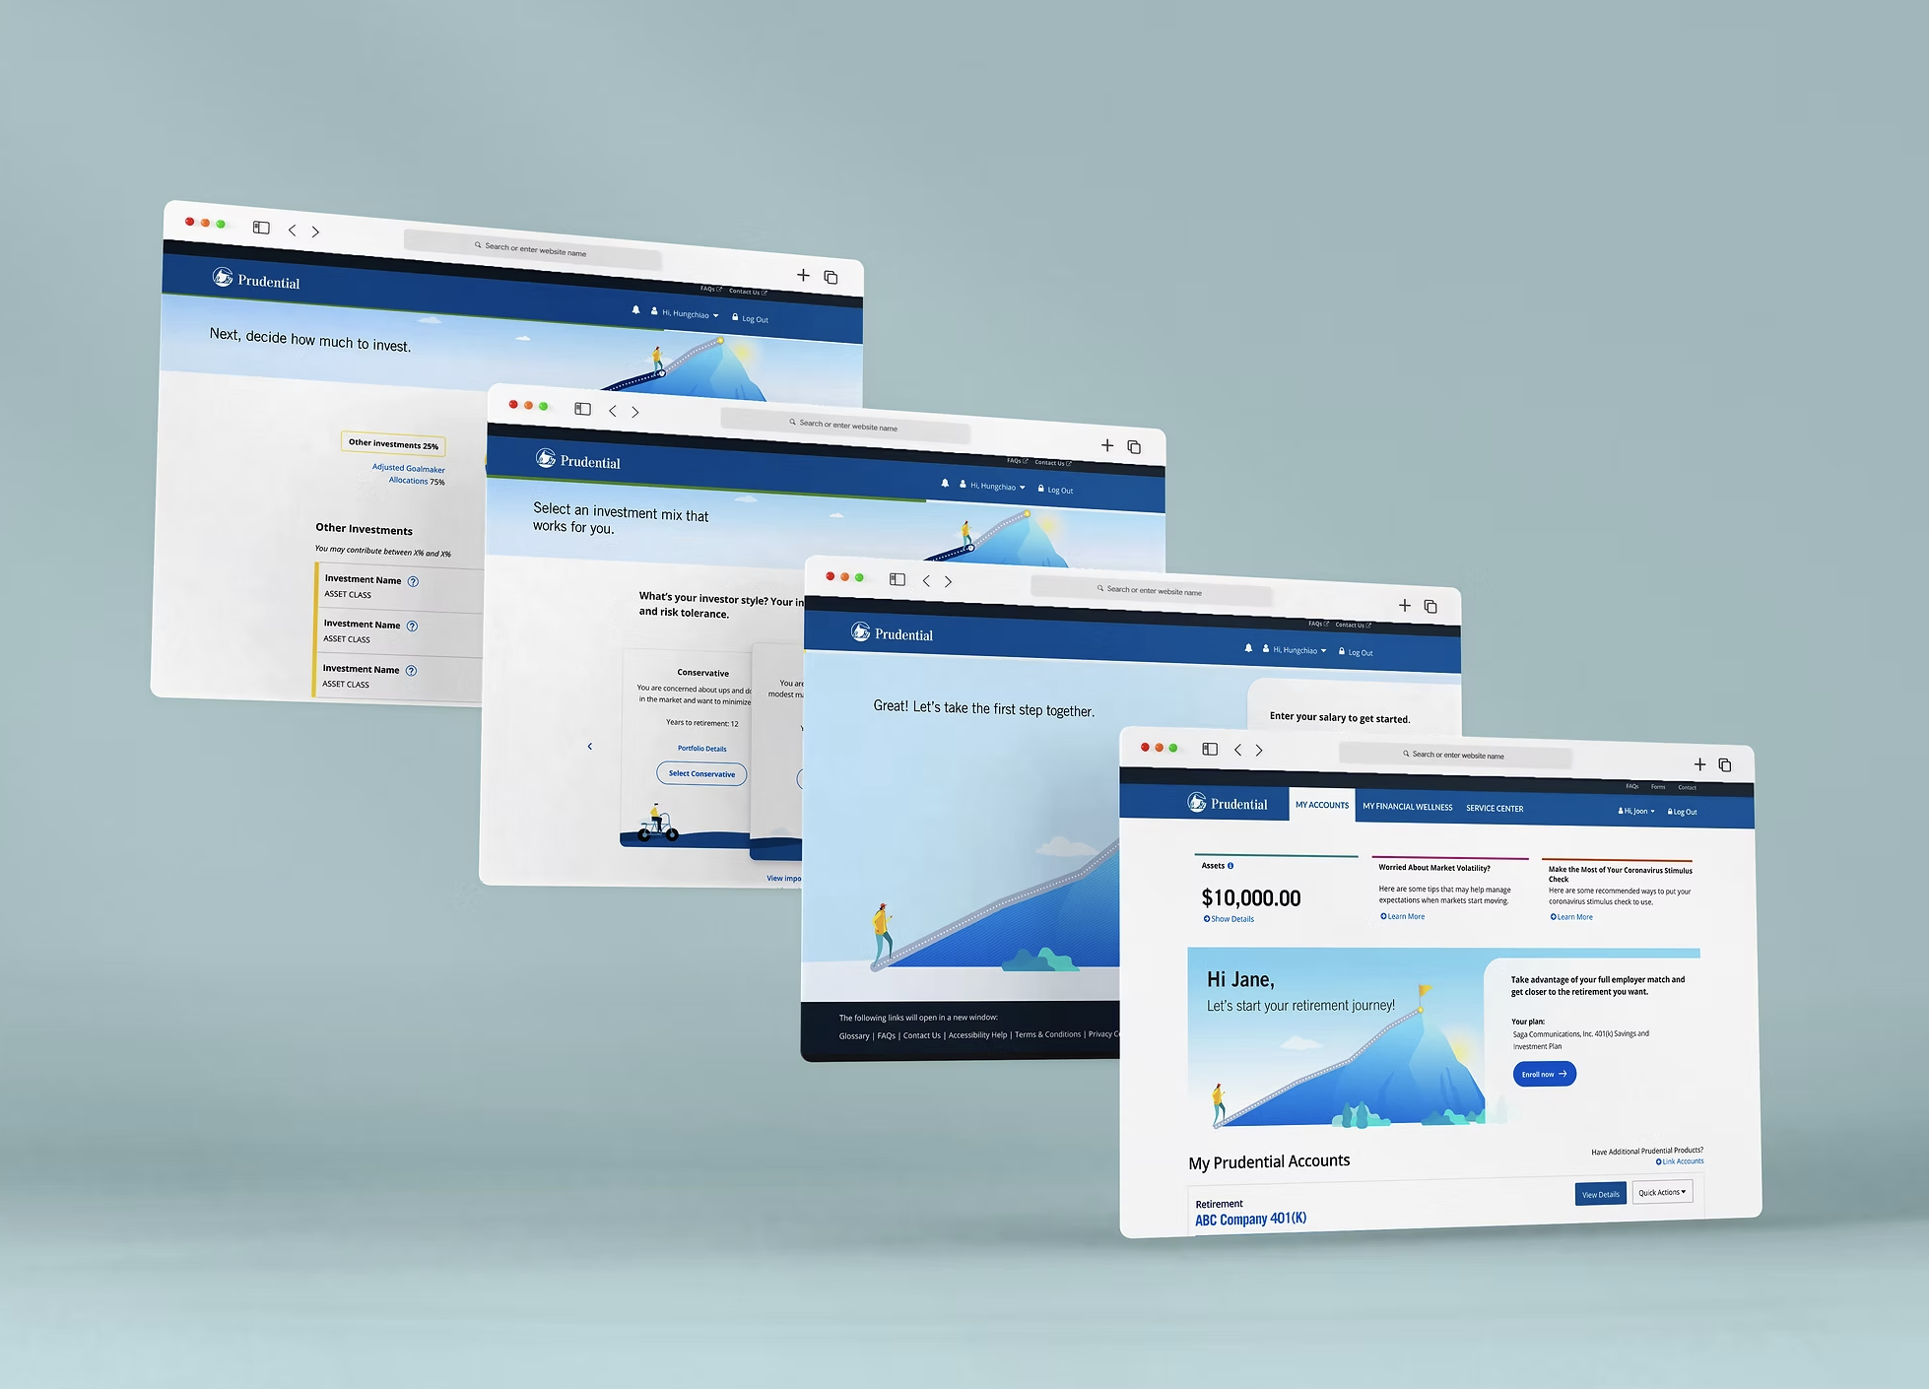
Prudential Financial
PruXpress
Design System & UX Transformation
Nat Slater | Lead Product Designer
natux.design · natslater95@gmail.com

Slide 2
CONTEXT
No Design Language
The
$44.2B
Problem
Every team shipped visually inconsistent UI. Trust eroded across the platform.
Slow Stakeholder Decisions
Without shared vocabulary, alignment required repeated cycles of expensive rework, while operating in a waterfall methodology.
Our goal of scale & velocity: one unified design foundation for the entire company.
PruXpress (Prudential's flagship advisor platform) operated across 8+ product teams with no shared design language, no common component library, and no unified UX direction. This caused the most friction for our advisors who needed experience of multiple tools for different lines of business, causing unnecessary cognitive load.
Fragmented Execution
8+ product teams operated in silos. No scalable system. No shared component library. This was also during the change of tools (Adobe to Figma)

Slide 3
FOUNDATION
Discovery & Problem Framing
01
Stakeholder Interviews
02
Problem Framing Workshop
Conducted comprehensive stakeholder sessions across 8+ product teams to surface pain points and organizational blockers.
Led a structured 4-part workshop (Establish → Justify → Contextualise → Define) to align leadership on what needed to be solved and why.
03
Swimlane Diagram (IPS-IR)
04
User Journey Mapping
Mapped role-based permissions and user flows across Servicing, Specialist, and Manager personas to align UX with technical feasibility.
Identified 'Nervous Anticipation' as a key UX blocker for PRT Annuitants — critical insight that became the design north star.
Key Insight: Annuitants' "Nervous Anticipation" about benefit changes was a business blocker — reducing friction became a strategic design priority.

Slide 4
DESIGN PRINCIPLES
The Trust Layer
Every design decision mapped to Nielsen Norman Group’s Hierarchy of Trust
P
V
C
E
Predictability
Visibility
Clarity
Efficiency
NN/G: Consistency
NN/G: Visibility of Status
NN/G: Match Real World
NN/G: Flexibility
Consistency over novelty. A system users can predict is a system users trust. Every component follows the same rules every time.
Standardized status messaging reduces anxiety. Annuitants always know where they are in the process, no dead ends, no guessing. Content design and guidelines around content were extremely helpful for these standard ui components.
Plain language UI replaced jargon (APRT/NRD). If users have to decode terminology, the design has already failed. The majority of my first weeks of working at Prudential was looking at spreadsheets of plain language and synthesizing them to user needs for better terminology.
Progressive disclosure for Advisor Dashboards. Power users get depth; new users get simplicity. One interface, multiple mental models. For prudential, they had different levels of access within each user type (ie. manager vs advisor portals, or policyholders vs. beneficiaries)

Slide 5
DESIGN SYSTEM
The Evolution Design System
A scalable, token-based system powering 8+ product teams across PruXpress
THE ENGINE
Design Tokens
Component Library
Data Viz Suite
— 8px grid system (New mobile first designs)
— Advisor dashboard modules
— Radial benefit charts
— Color ramps (brand + semantic)
— Status messaging patterns
— Area/line projection views
— Spacing & typography scales
— Data entry & form controls
— Interactive modeling sliders
— Motion & elevation values
— Navigation & modal systems
— Accessible color palettes
WCAG 2.1 Accessible · Dev-Ready Tokens · Figma + Storybook · Web Controls Integration · Calc Engine Ready

Slide 6
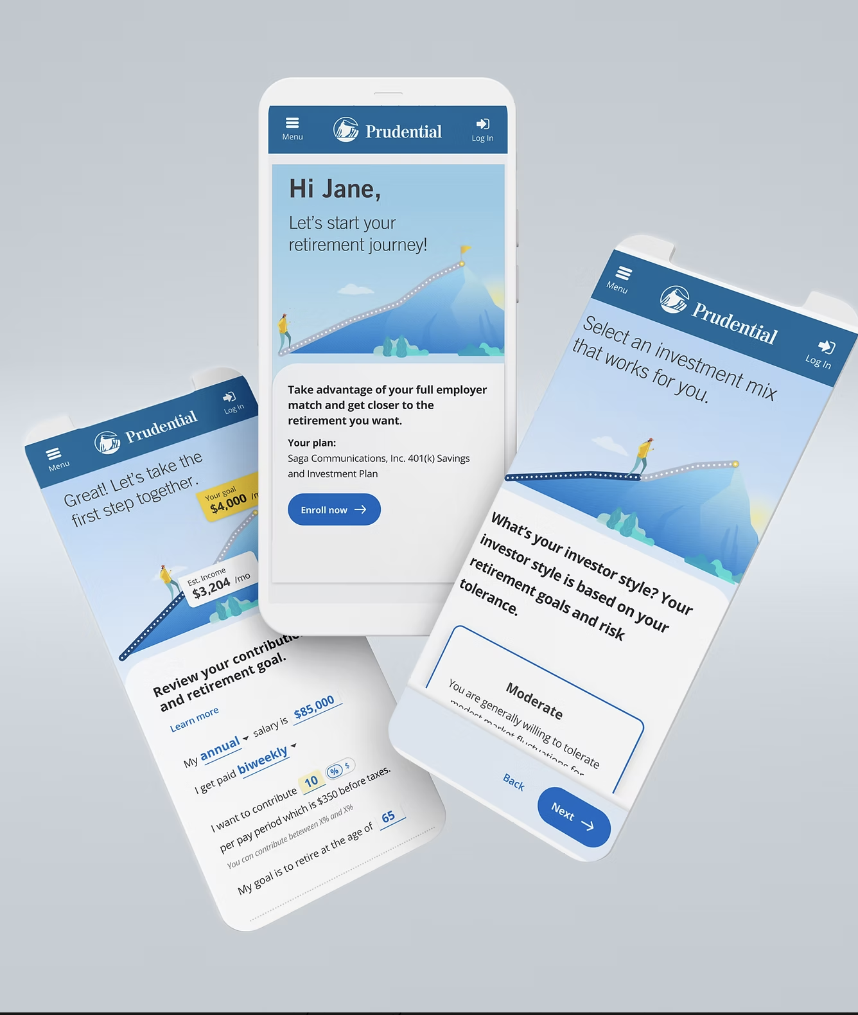
COMPONENT ANATOMY
Retirement
Modeling
Tool
The most complex component in the system: required multi-state logic, accessibility compliance, and real-time calculation engine integration.
WCAG 2.1 AA
Full keyboard nav, screen reader labels
State Logic
Empty / Loading / Error / Results / Saved
Web Controls
Feature-flagged per Contract + Participant
Calc Engine
Async API with inline progress feedback

Slide 7
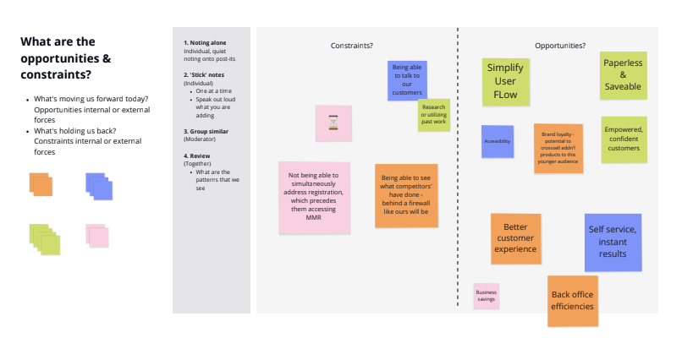
STAKEHOLDER ALIGNMENT
Design Lead as Facilitator
01
Ran 4-Part Problem Framing Workshops
“
Led cross-functional sessions with PMs, Engineering leads, and business stakeholders to align on the "why" before touching any design.
Responsible for transforming the design process and establishing a unified design language across the entire organization.
02
Built a Shared Vocabulary
Created a design glossary bridging Engineering and Business language — reducing translation time at every handoff.
— Stakeholder brief, PruXpress engagement
03
Embedded Feedback Loops
Alignment is not a soft skill, but a design deliverable.
Introduced iterative prototype reviews at every milestone, eliminating late-stage surprises and reducing rework cycles.

Slide 8
IMPACT
Results
Improved decision-making speed and design efficiency across the entire organization
40%
8+
$44.2B
Reduction in Design-to-Dev
Handoff Time
Product Teams Using the
Scalable Design System
Platform Vision
Redefined
Shared component library eliminated redundant spec documentation, and artifacts for the development teams across Prudential.
Single source of truth adopted org-wide within 6 months, with a shared understanding of Agile training to better adjust for phased approaches.
Design strategy directly shaped Prudential's flagship business platform, and completed our digital transformation in the company to reduce friction for both our advisors and customers whom were still stuck in paperwork.

Slide 9
LESSONS IN LEADERSHIP
Key Takeaways
01
Systems thinking is an act of organizational care.
A unified design system doesn't just improve consistency, it transforms how teams collaborate, make decisions, and establish trust with one another.. The real product was the foundation itself.
02
Alignment is a design deliverable.
Investing time in workshops and shared vocabulary at the beginning pays exponential dividends throughout execution. Stakeholder buy-in is not overhead, it is the work. A large amount of the digital transformation project required patience and language adaptability (code switching)
03
Build with teams, not for them.
True impact comes from changing how an organization approaches design, not just delivering beautiful screens. The best design leaders make the team around them more effective, and remove any blockers along the way.

Slide 10
Thank You
Let's talk about what we can build together.
Nat Slater
Lead Product Designer
natslater95@gmail.com · natux.design

